Slide 1
Lecture 8: Programming Languages

Slide 2
Outline
What is a program
What is a programming languages
Why we need them
Fundamentals
Categories
Compiling a programming language
Pseudo code
Algorithms
Flow chart

Slide 3
What is a program
A list of instruction write in a sequence to perform a specific task or to provide a solution for a given problem
Example:
Problem: How to save a word document
Program:
1: Declare and initialization: MS word open
2: Click on file
3: Click on save option

Slide 4
What is a programming languages
A programming language is use to write a program in structured form
It define the structure of a language

Slide 5
Why we need a programming language
It is design to communicate with a machine and to control the behavior of a machine

Slide 6
Fundamental of any language
Any language should have proper syntax and semantics

Slide 7
Fundamental of any language
Syntax
Tell us about the structure of a sentence
Statements written in proper structural form has a right syntax
Example:
My name is hani Correct
My hani name is In Correct

Slide 8
Fundamental of any language
Semantics
Meaning of a sentence
Statements written in a structure form is not necessarily have semantics
Example:
My name is Hani Correct
My name is human In Correct

Slide 9
Categories of Programming Languages (1)
Machine Language
Assembly Language
Third Generation Languages
Fourth Generation Languages (4GLs)
5th generation languages
Object-oriented languages
Query languages
Structured query language (SQL)

Slide 10
Basic Terms Used in programming languages:
Language translator
Systems software that converts a programmer’s source code into its equivalent in machine language
Source code
High-level program code written by the programmer
Object code
Another name for machine language code

Slide 11
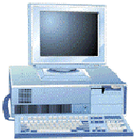
Programming Languages: Terminology (2)
Interpreter
A language translator that translates one program statement at a time into machine code
Program statement
Interpreter
Machine language statement
Statement execution

Slide 12
Programming Languages: Terminology (3)
Compiler
A language translator that converts a complete program into machine language to produce a program that the computer can process

Slide 13
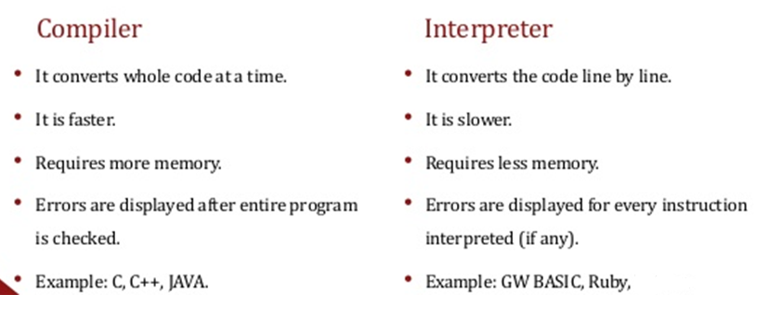
Difference between a Compiler and interpreter

Slide 14
Step 1: Translate program
Computer program
(Source code)
Compiler
Machine language program
Step 2: Execute program
Machine language program
Program execution

Slide 15
Algorithm
A step by step procedure
Have specific known time to run
Easy for programmer to convert algorithm in source code

Slide 16
Flow charts
A flowchart is a type of diagram that uses an algorithm, workflow or process, showing the steps as boxes of various kinds, and their order by connecting them with arrows
Define the flow of a program using diagrams
We use different shapes to design a flow chart

Slide 17
Flow chart
Start/End
Start / End
Input/output
Compute
Input /output
Compute

Slide 18
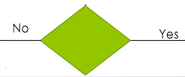
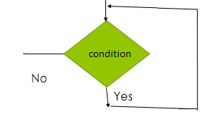
If/else
While/endwhile

Slide 19
Example
How to make a tea
How to add two numbers

Slide 20
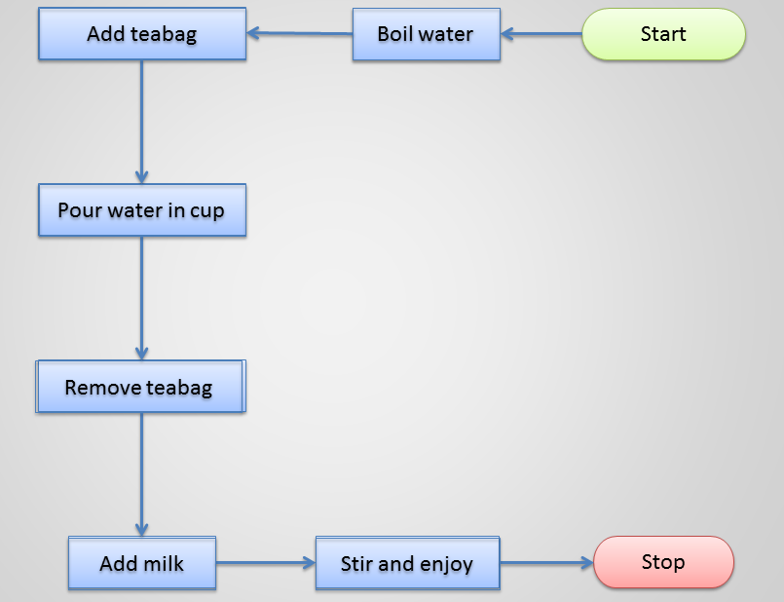
How to make tea

Slide 21
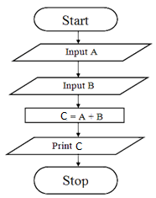
How to add two numbers

